Slide 1
Software Development on Java
Dzmitry Marchankau 2023

Slide 2
Core Java
OOP paradigm
Data structures and collections
Classes and Objects
Abstraction Interfaces and abstract classes
String handling Garbage collector(?)

Slide 3
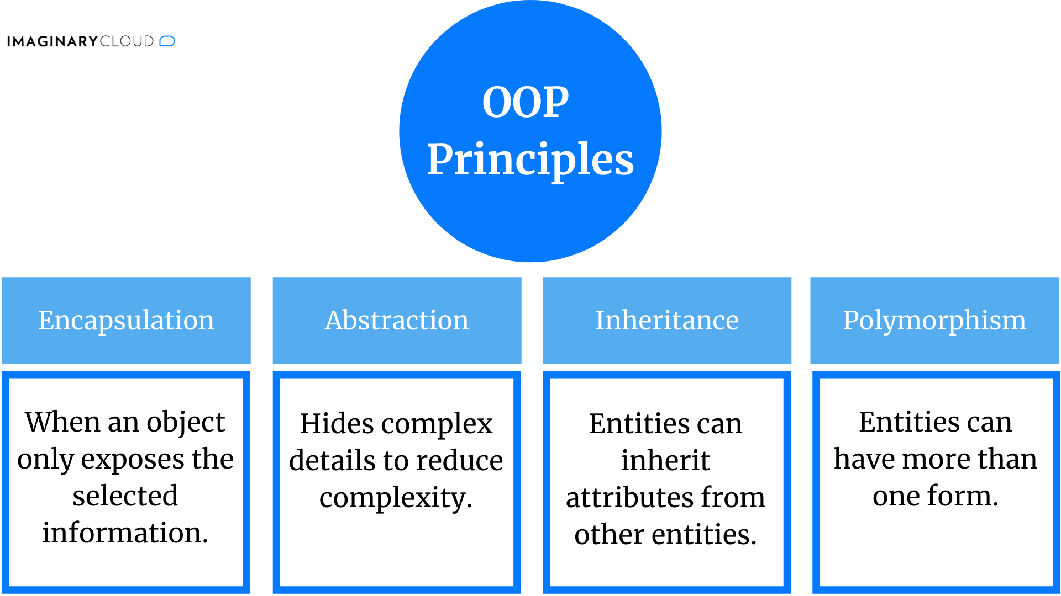
Object oriented programming
Object-oriented programming (OOP) is a programming paradigm based on the concept of "objects", which can contain data and code: data in the form of fields (often known as attributes or properties), and code, in the form of procedures (often known as methods).

Slide 4
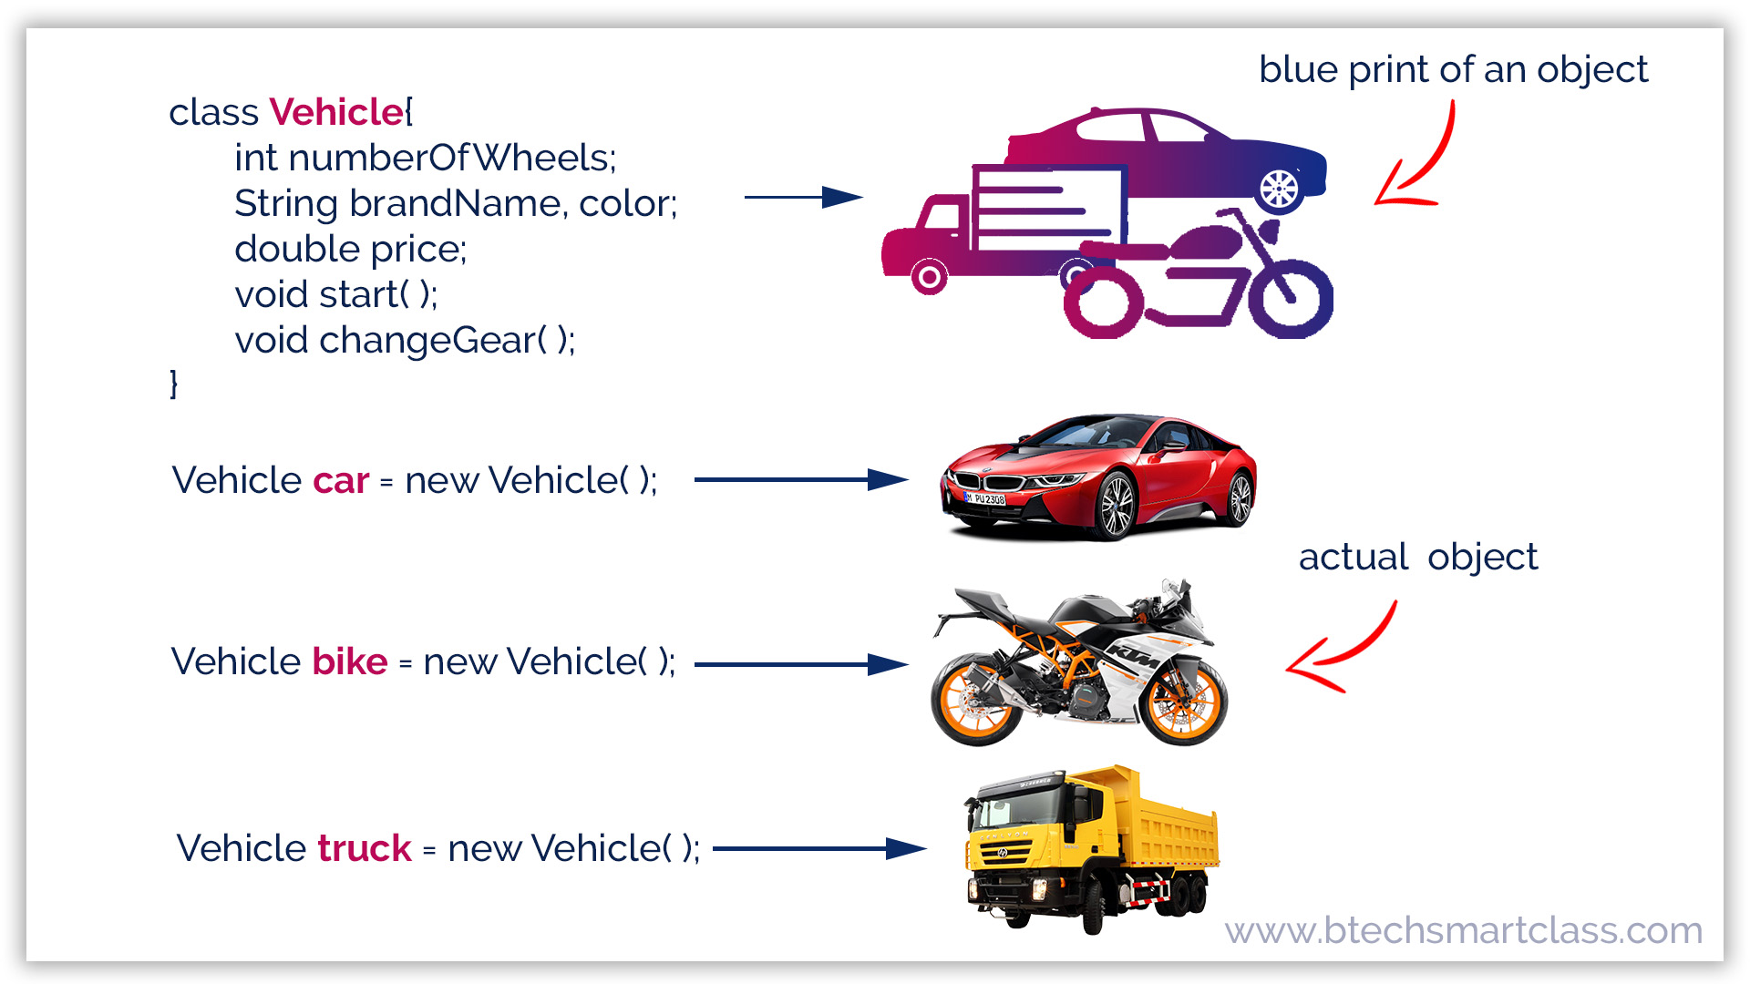
Classes and objects

Slide 5
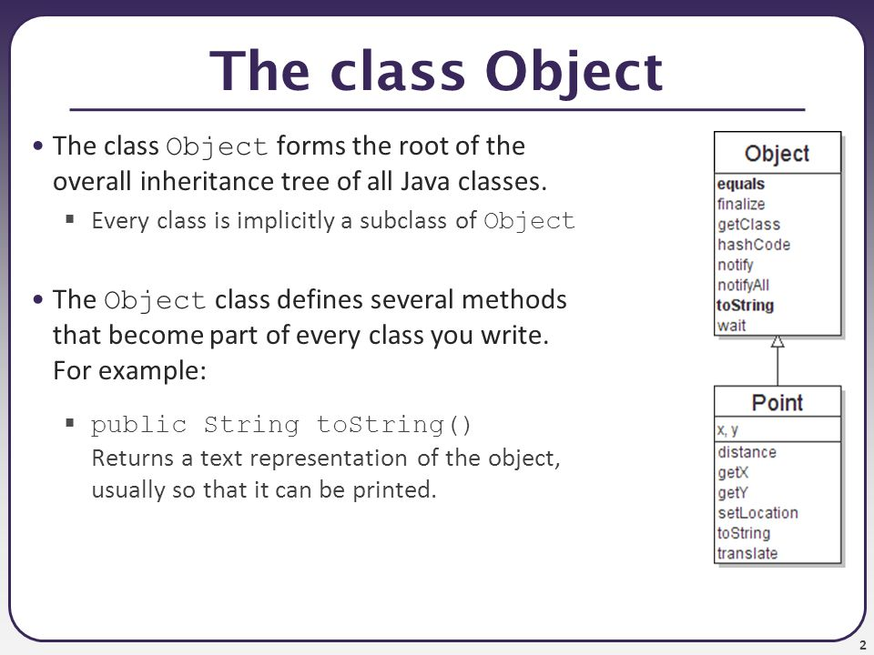
Object class

Slide 6
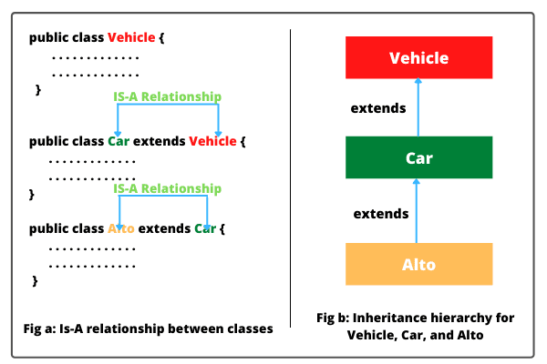
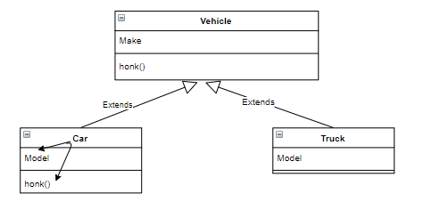
Inheritance

Slide 7
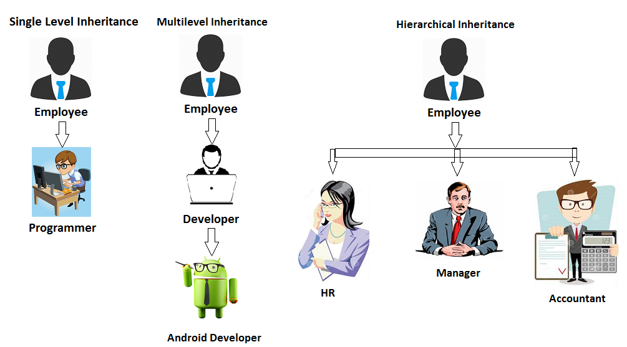
Inheritance

Slide 8
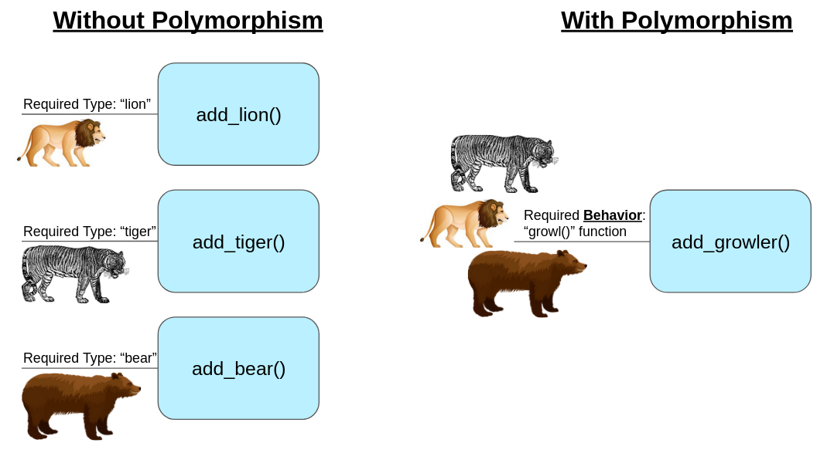
Polymorphism

Slide 9
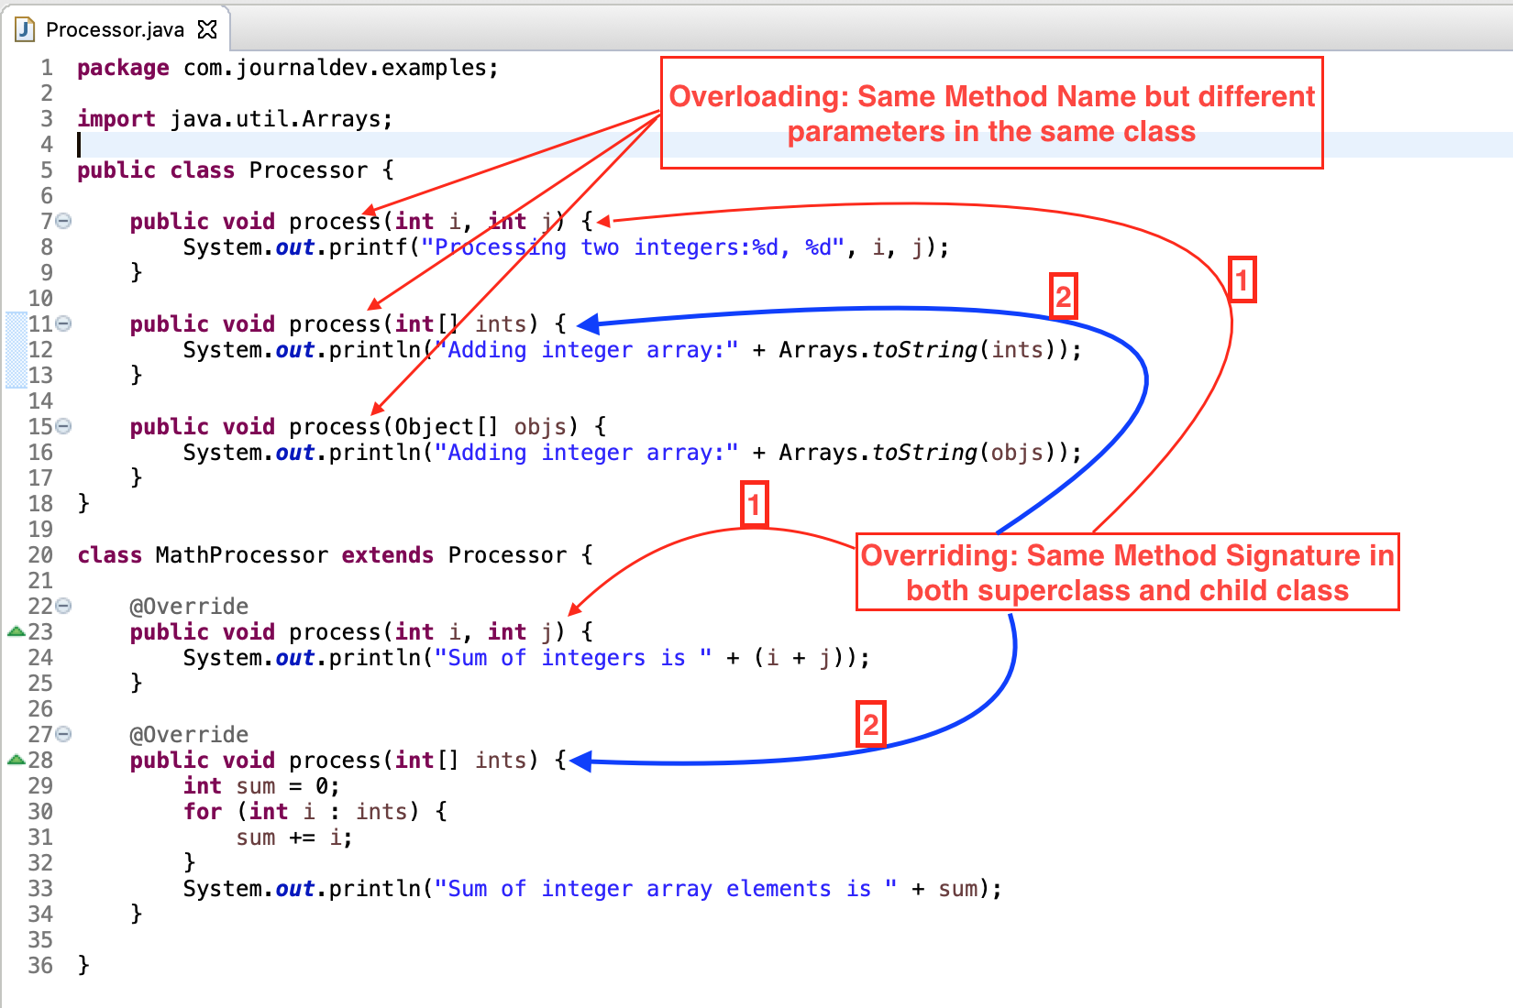
Methods overriding and overloading

Slide 10
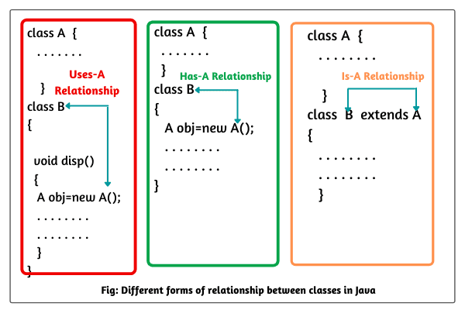
Types of relationship

Slide 11
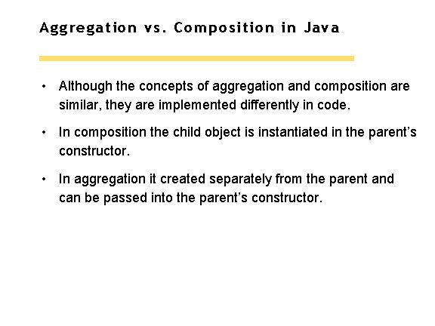
Aggregation and composition (Has-A)

Slide 12
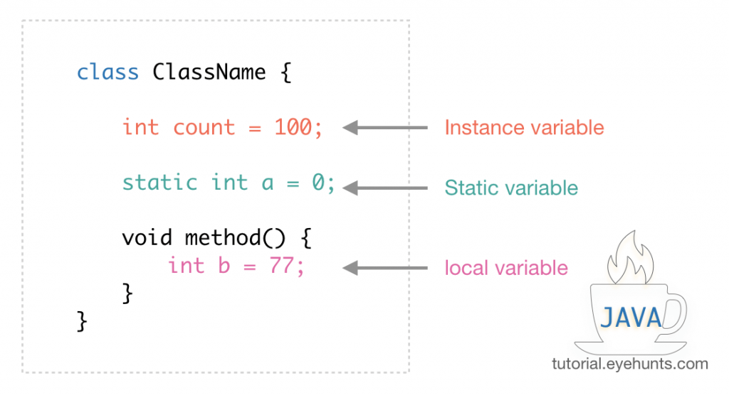
Java variables

Slide 13
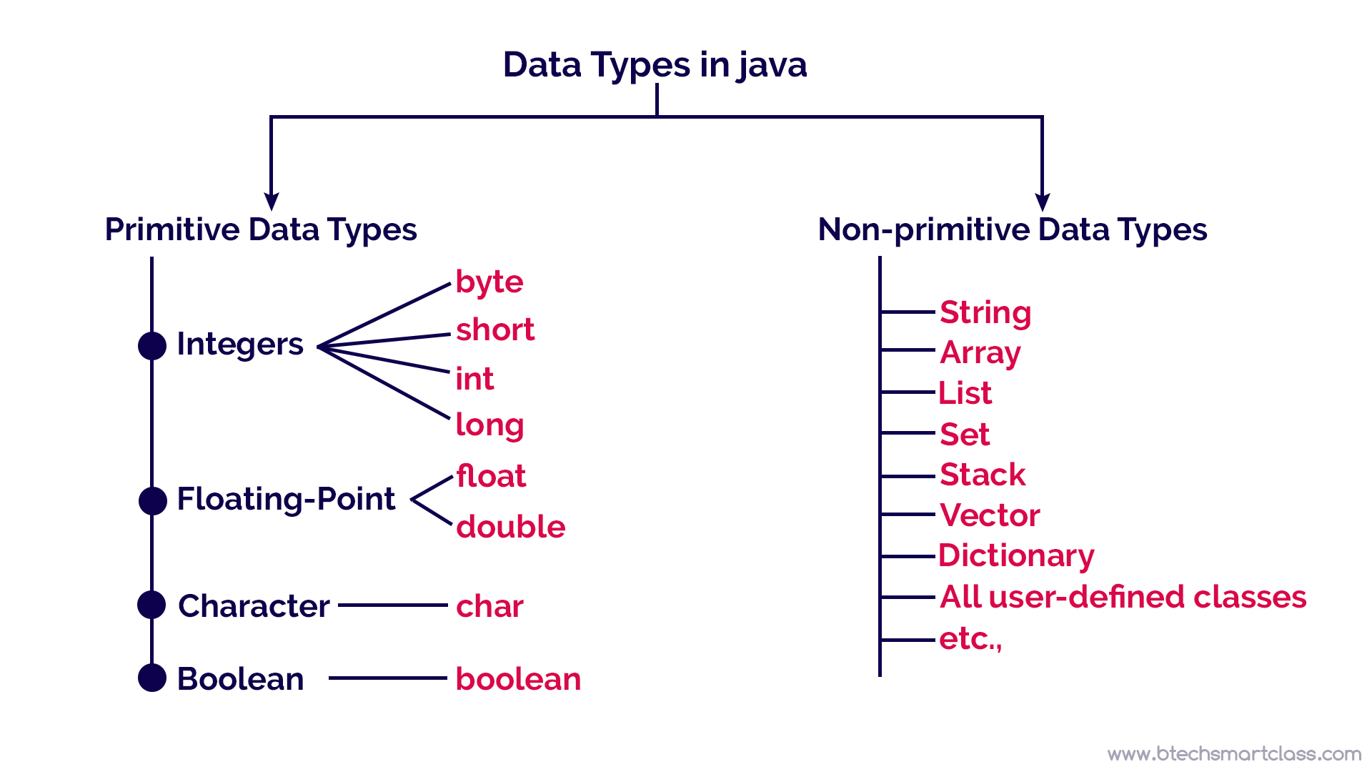
Java Data Types

Slide 14
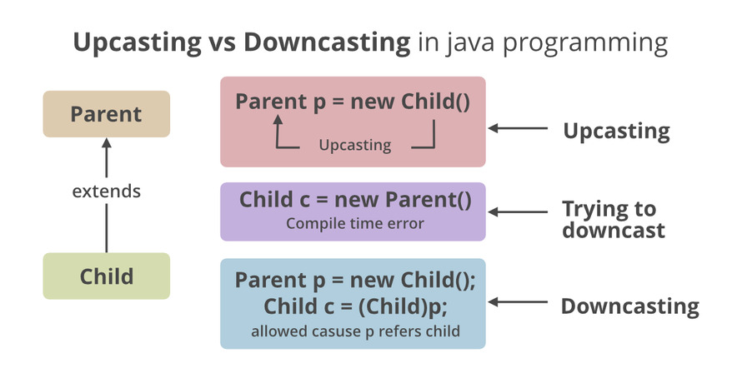
Java type casting

Slide 15
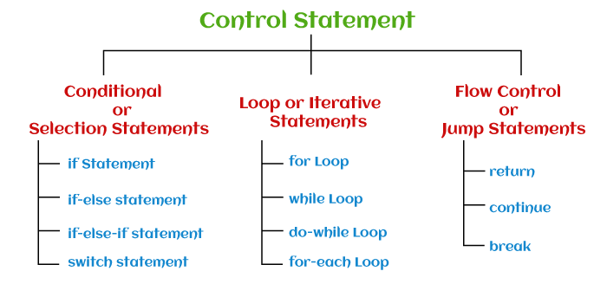
Control statements

Slide 16
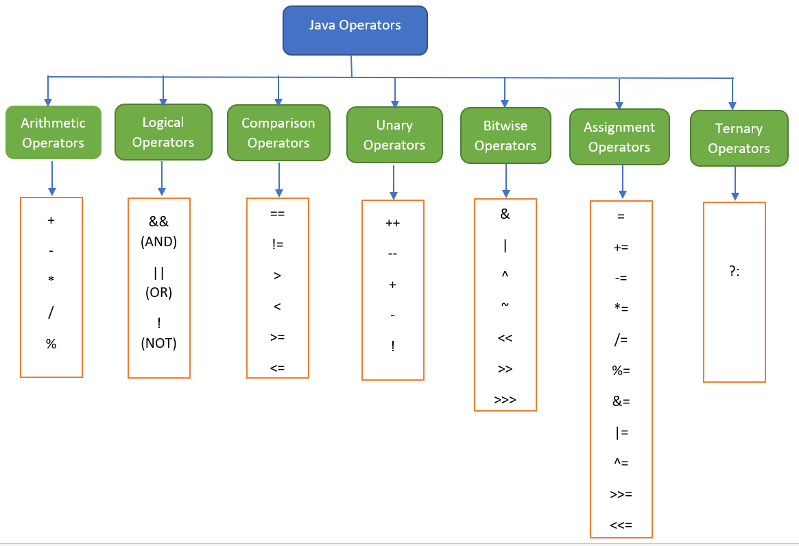
Java operators

Slide 17
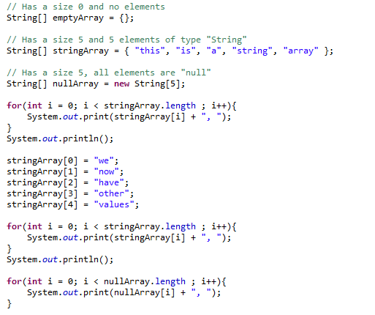
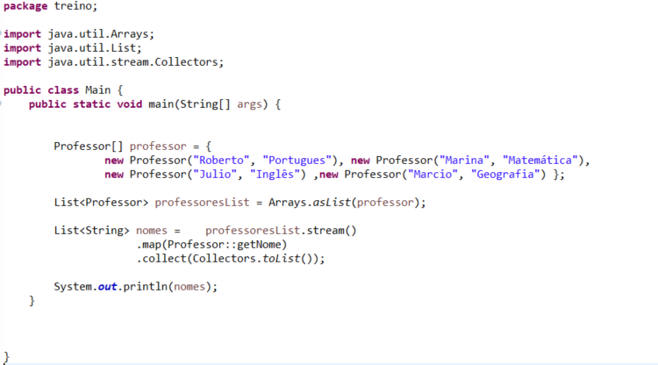
Java arrays

Slide 18
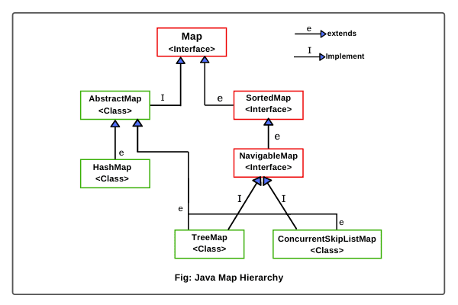
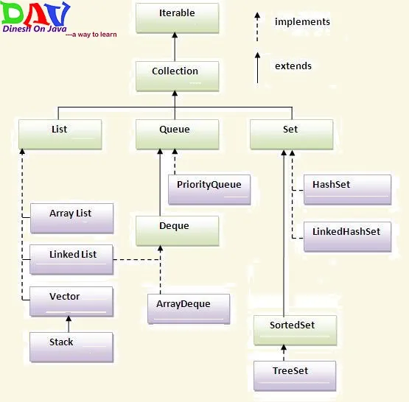
Java collections

Slide 19
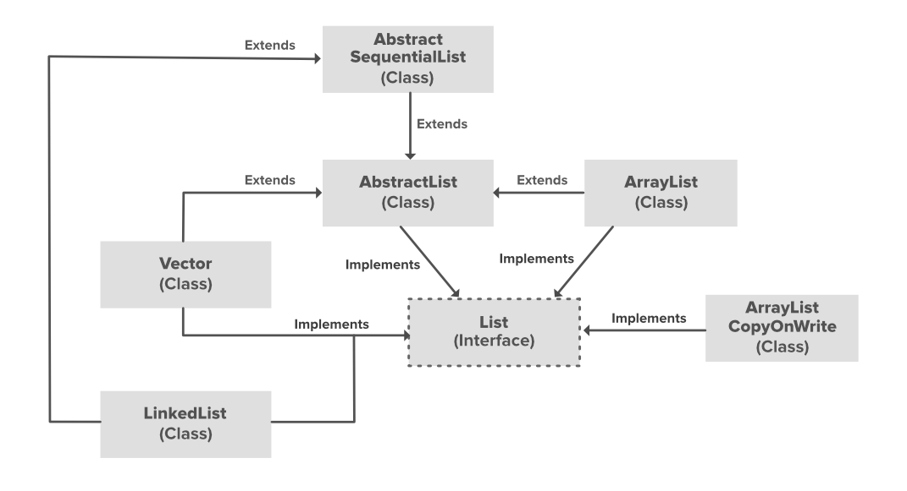
List Interface

Slide 20
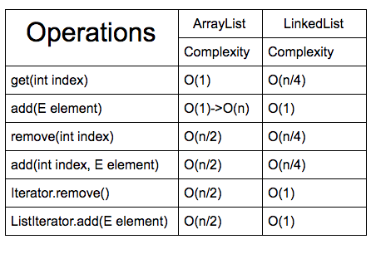
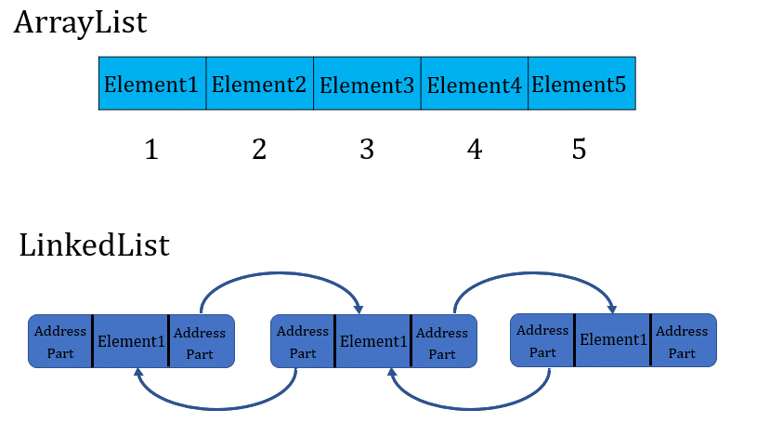
ArrayList vs LinkedList

Slide 21
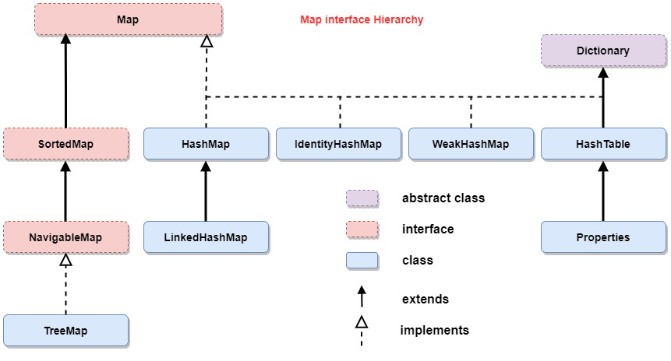
Map interface

Slide 22
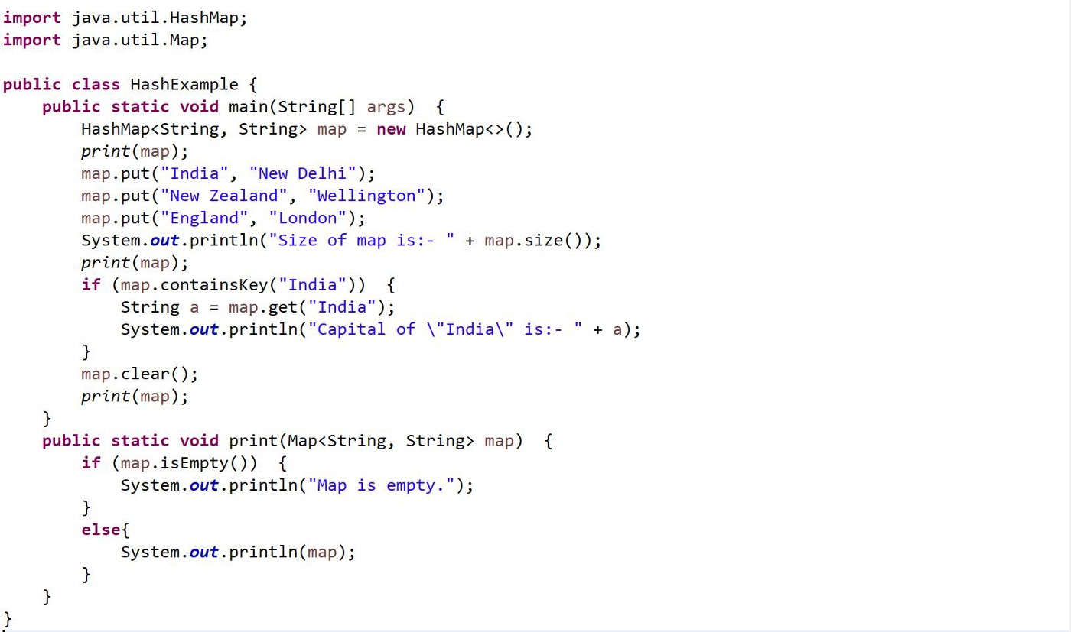
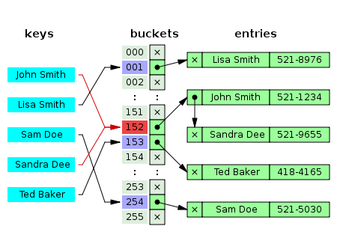
HashMap

Slide 23
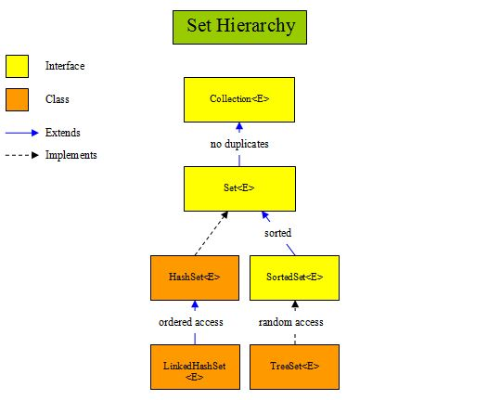
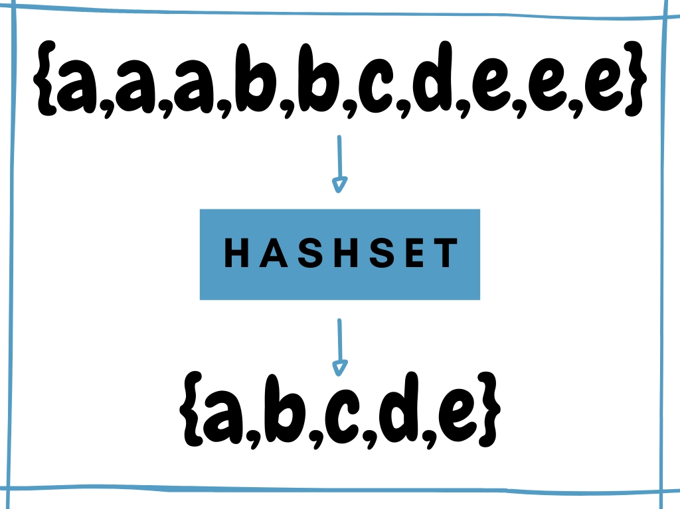
Set interface

Slide 24
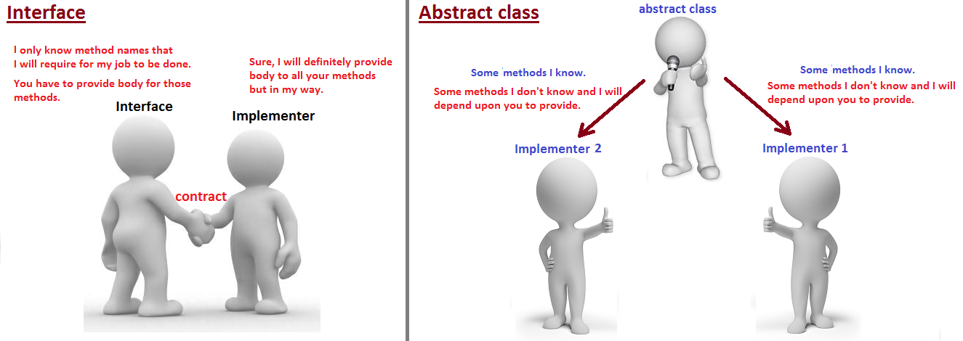
Interface vs Abstract Class

Slide 25
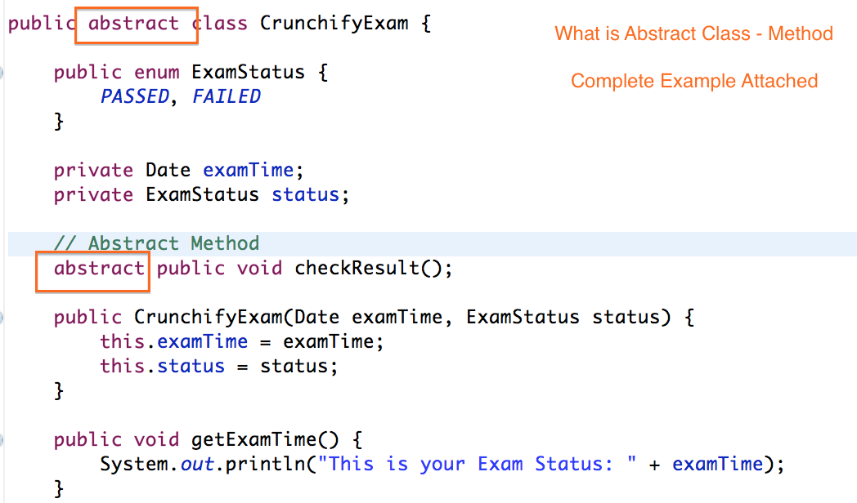
Abstract Class usage

Slide 26
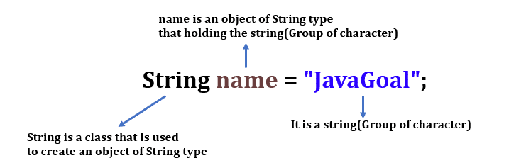
String in Java

Slide 27
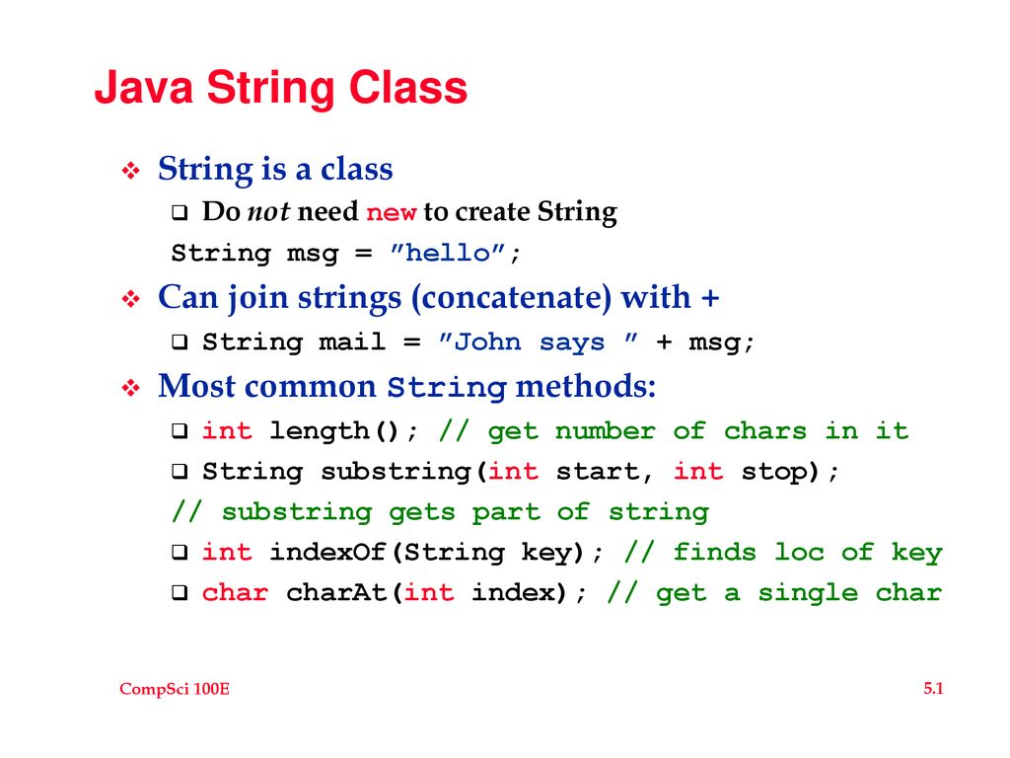
String in Java

Slide 28
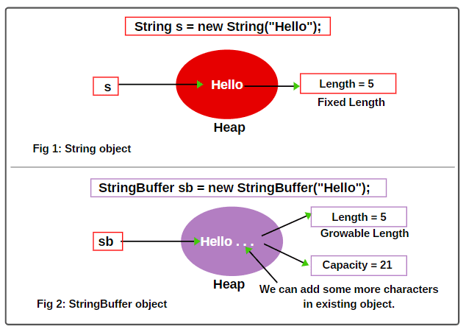
String vs StringBuffer(StringBuilder)

Slide 29
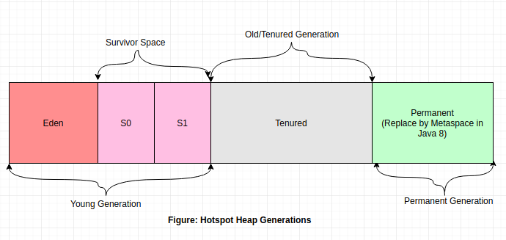
Java memory management

Slide 30
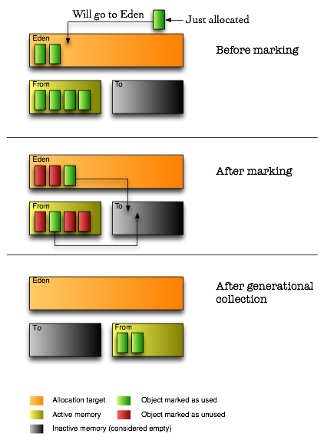
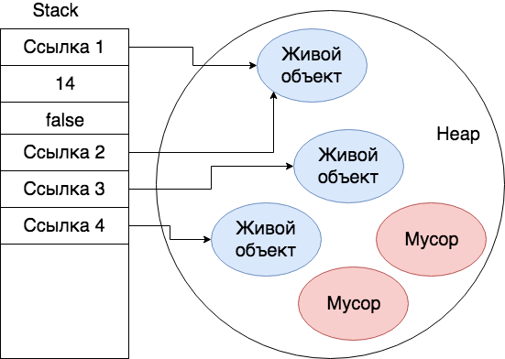
Garbage collector

Slide 31
Questions ?

